Slide 1
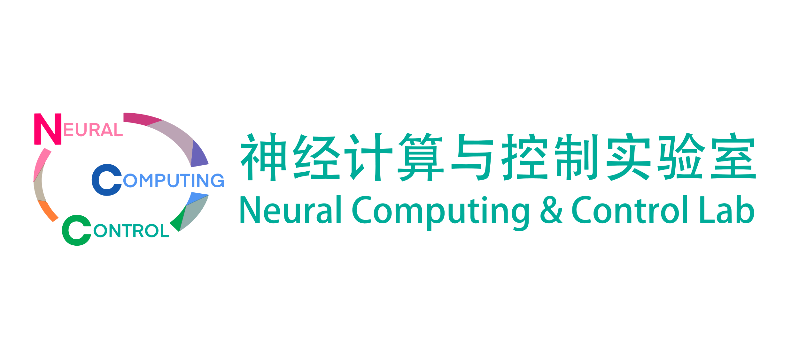

Machine Learning and Medical Engineering Applications 机器学习与医学工程应用
Lecture 1 - Introduction to the course
Quanying Liu （刘泉影）
SUSTech, BME department
Email: liuqy@sustech.edu.cn
BME215001, Spring term, 2023

Slide 2
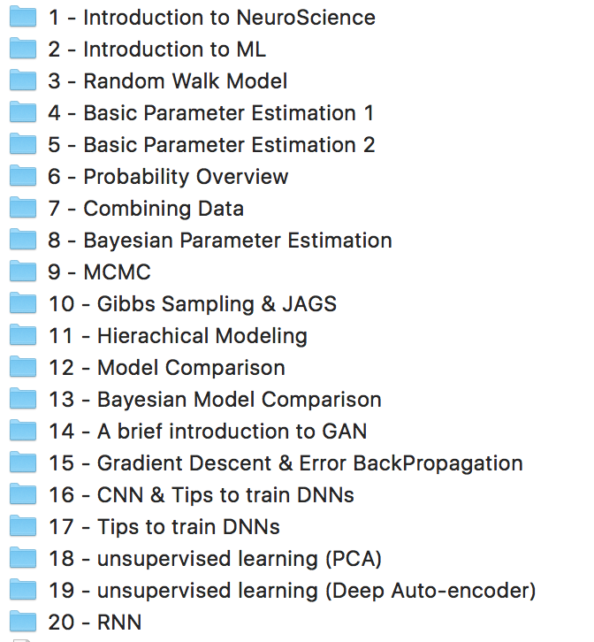
Machine Learning & NeuroEngineering (ML&NE) in 2020
Computational modelling
Neuroengineering techniques are integrated into the models.
Deep learning

Slide 3
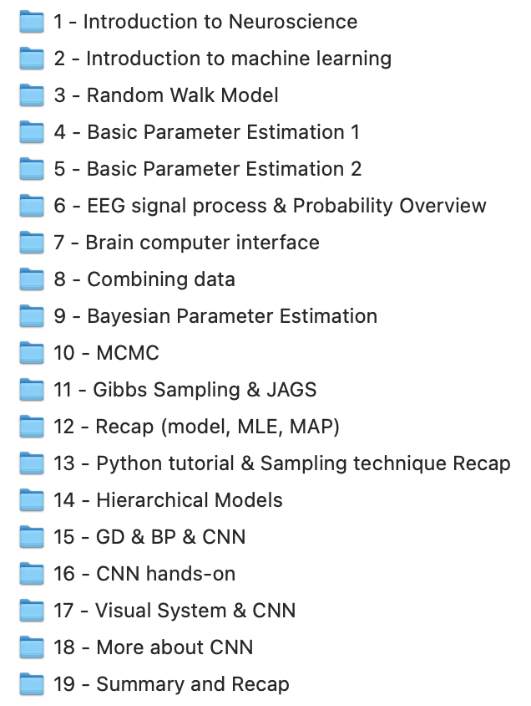
Machine Learning & NeuroEngineering (ML&NE) in 2021
Computational modelling
Add specific lectures for Neuroengineering techniques.
Deep learning

Slide 4
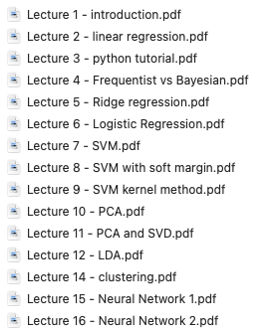
Machine Learning & Medical Engineering Applications in 2022/2023
This course focuses on machine learing.
Neural engineering is another course.

Slide 5
Goals of ML&NE
Learn the neural basis of brain intelligence (how brain generates intelligence)
visual system
auditory system
motor system
decision making
…
Learn basic algorithms for artificial intelligence (how machine generates intelligence)
CNN
RNN
GAN
…
Do a course project (to bridge BI and AI)
propose a project to solve a scientific/technical question
use some AI methods on your data
make a course presentation
Poster Day (present your posters in front of the 工学院南楼5楼)

Slide 6
Goals of ML&MEA
Totally orientated to machine learning methods (Basic ML theory and models)
Linear regression
Logistic regression
Support vector machine (SVM)
Clustering
Dimensionality reduction
Fully-connected Neural Network
Convolutional neural network (CNN)
Programming, Implementation and Applications (Apply ML to medical engineering)
Python programming
Model Implementation
Medical applications
Homeworks and Exams
Homeworks (including theory and coding)
A final exam

Slide 7

Logistics
Class hours:
Tuesday, 10:20-12:10 (each week, 一教406)
Thursday, 19:00-20:50 (odd weeks, 一教406)
Lecturer: Quanying Liu (刘泉影)
My Office hours: Tuesday, 13:00-14:00, Engineering building South (工学院南楼) 535
Lunch hours: Please send an email to make an appointment for having lunch together.
Textbook
Pattern Recognition and Machine Learning, by Christopher M. Bishop
Reading materials (for extra learning)
Machine Learning: A Probabilistic Perspective, by Kevin P. Murphy
NCC lab
微信公众号

Slide 8
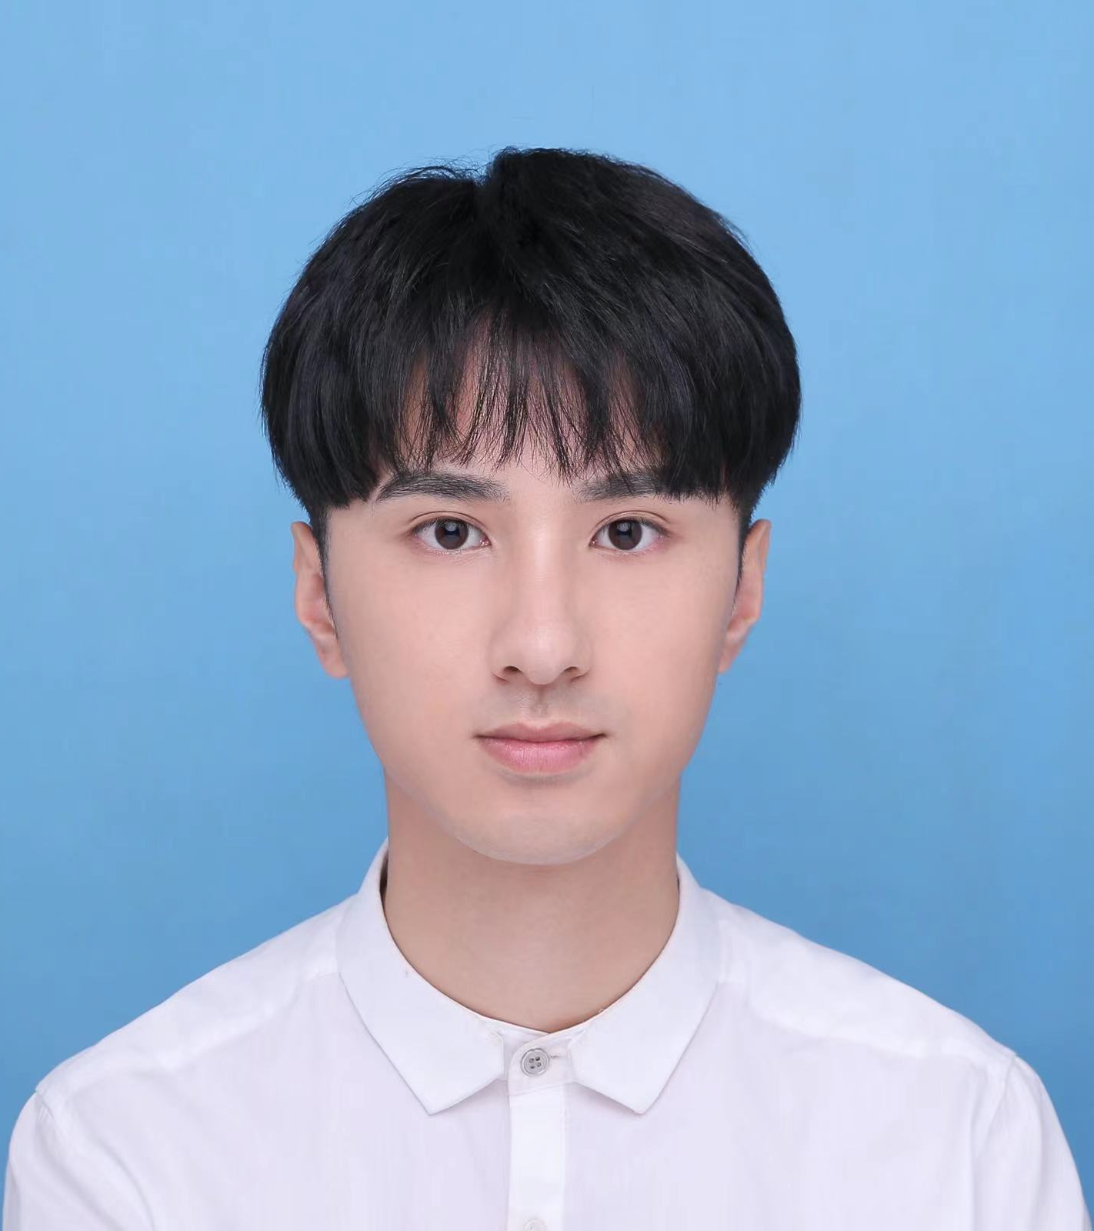
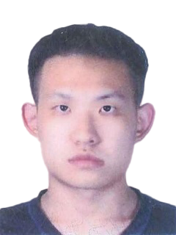

Logistics
TAs:
Junjie Yu (余俊杰)
Menglong Zhang (张梦龙)
Prerequisits
Basic linear algebra
Basic probability
Scoring:
30% Quiz at the class
Please attend the class!
40% Homework sets
A homework set includes two parts (theory and coding)
30% Final Exam
Not hard
工学院南楼541
余俊杰
张梦龙

Slide 9
Q1
Why are you interested in machine learning?
Notes:
Then we raise up a question.
Is there any similarities between brain and AI when performing the object recognition tasks?
The answer is yes. Plenty

Slide 10
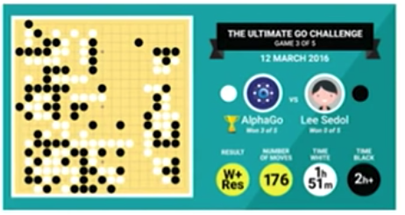
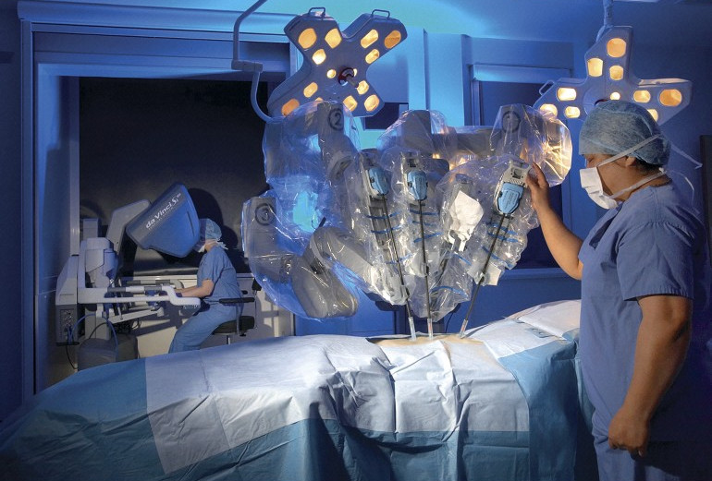
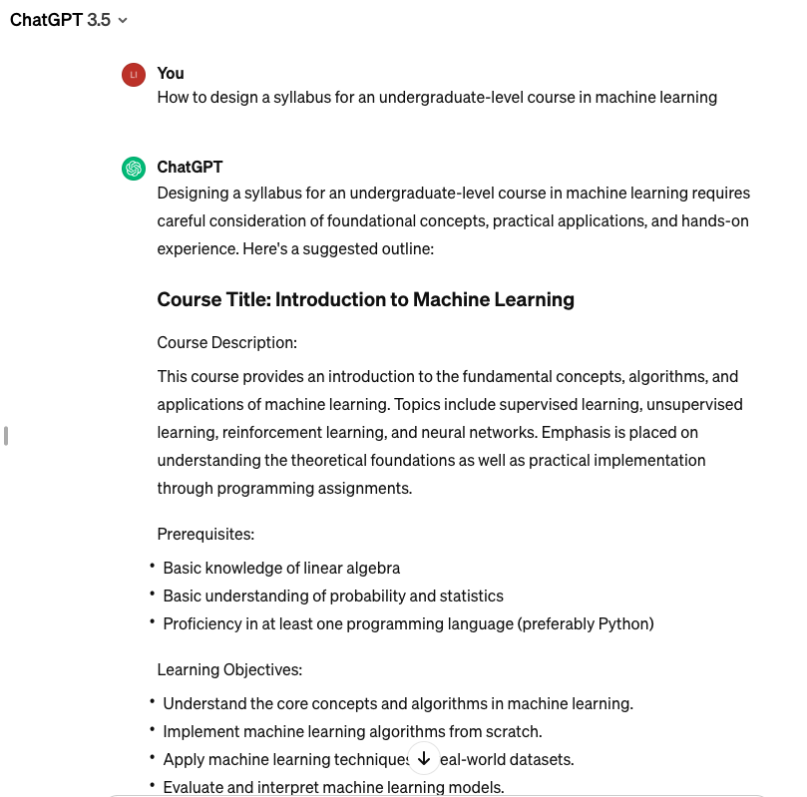
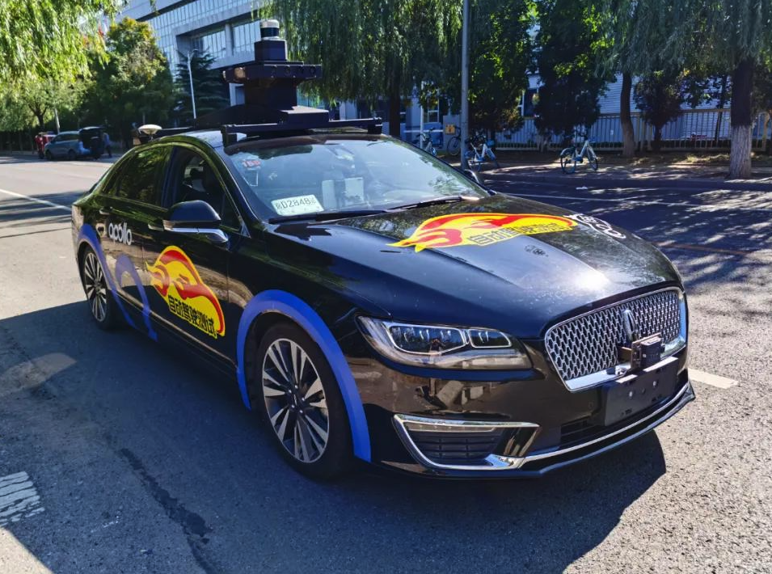
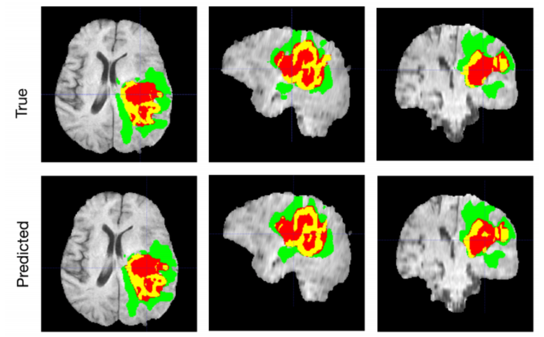
Machine learning is everywhere.
AlphaGo
da Vinci Surgical System
Autonomous Vehicles
Image processing
ChatGPT

Slide 11
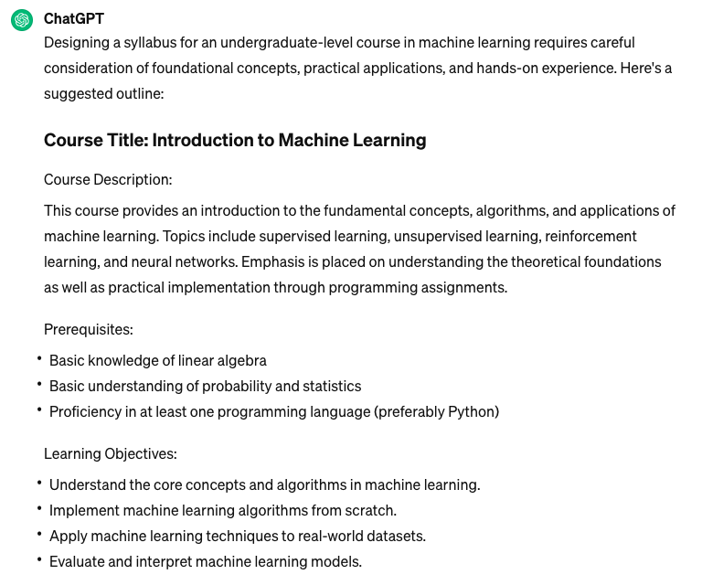
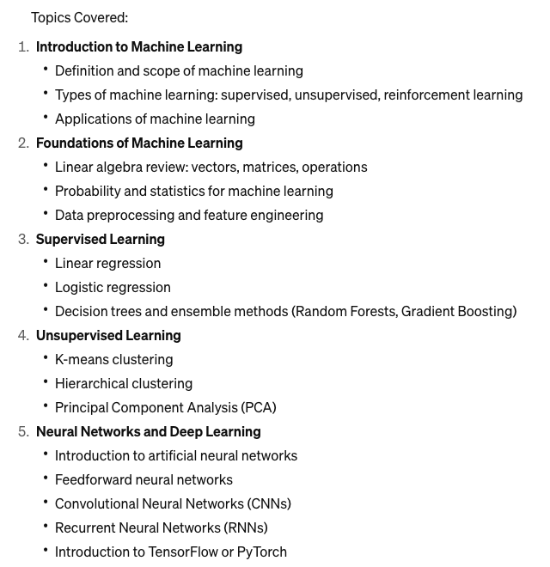
Large models: a way towards AGI

Slide 12
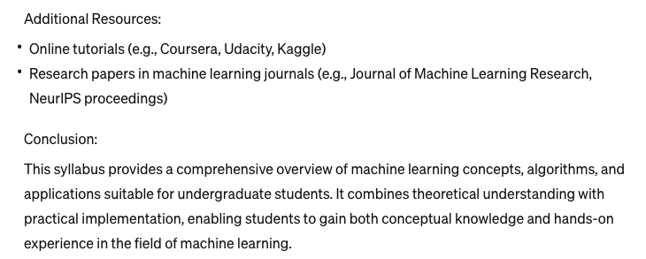
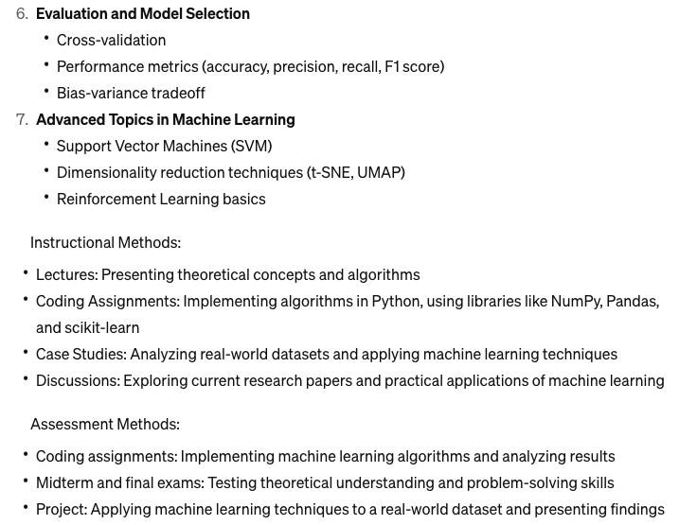
Large models: a way towards AGI

Slide 13
Q2
What is machine learning?
Notes:
Then we raise up a question.
Is there any similarities between brain and AI when performing the object recognition tasks?
The answer is yes. Plenty

Slide 14
Artificial Intelligence
general way for any non-human intelligence
Machine Learning
methods to let machines learn by themself
Deep Learning
a particular kind of machine learning using deep neural networks
Large language model
a deep learning algorithm that can perform a variety of natural language processing tasks

Slide 15
6 steps to be an AI expert
MIT 18.06 - Prof. Gilbert Strang
MIT 6.012 - Prof. John Tsitsiklis
Any programming course, with lots of practices
Stanford/Coursea - Andrew Ng
Stanford CS231n – Prof. Fei-fei Li
Linear algebra
Probability
Python
Machine Learning
Convolutional Neural Networks for Visual Recognition
Graph models/generative models/...
1
2
3
4
5
6

Slide 16
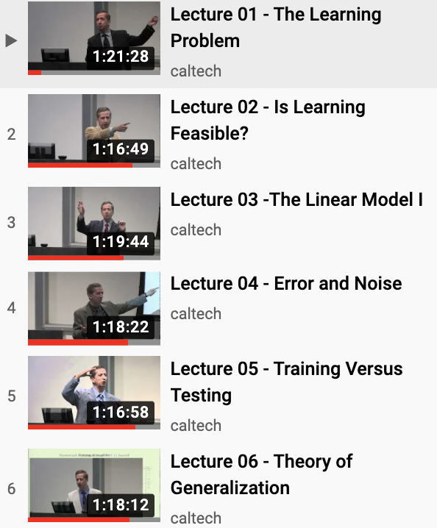
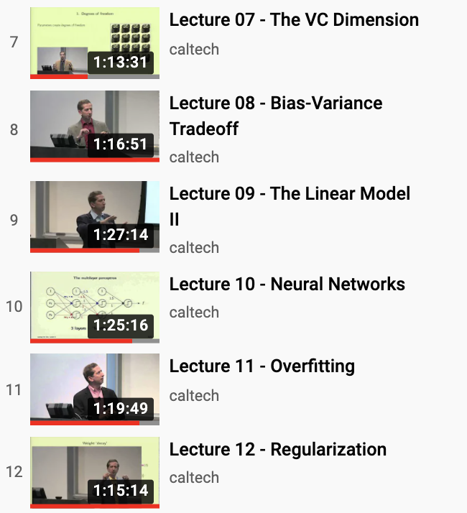
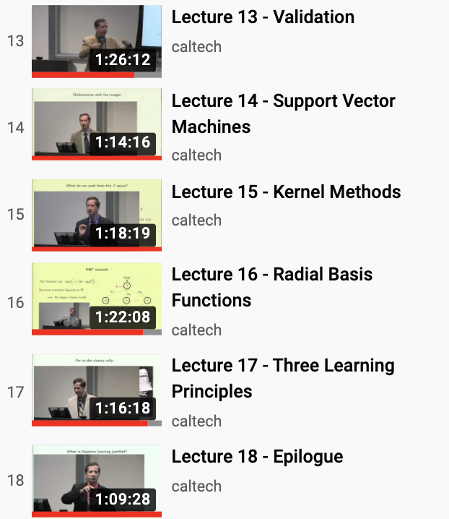
Caltech Machine Learning course
CS 156, by Prof. Yaser Abu-Mostafa
https://www.youtube.com/watch?v=mbyG85GZ0PI&list=PLD63A284B7615313A

Slide 17
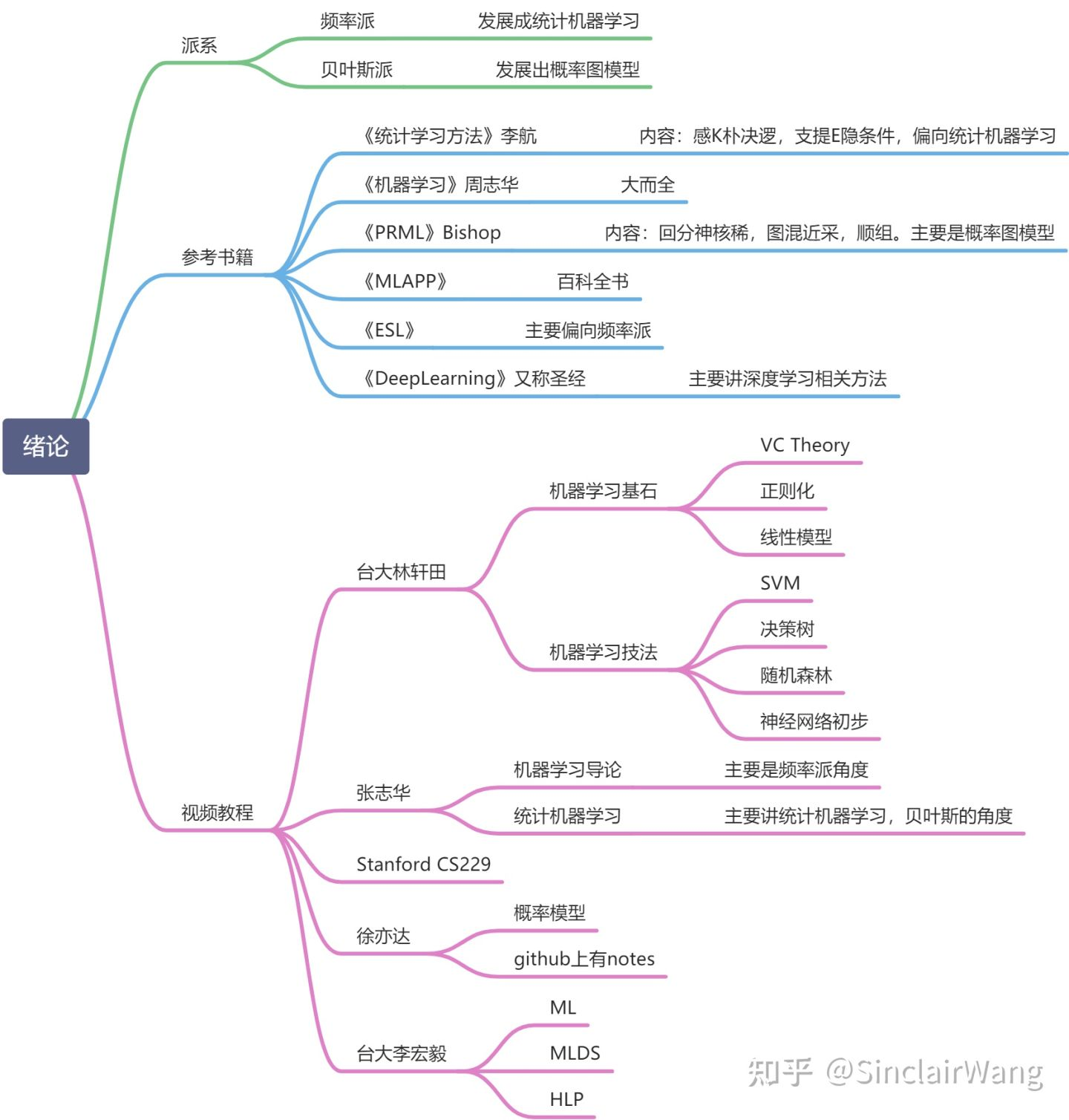
B站大学
【机器学习】白板推导系列, by shuhai008
https://www.bilibili.com/video/BV1aE411o7qd
包罗万象，因有尽有
纯理论推导
机器学习
白板推导

Slide 18
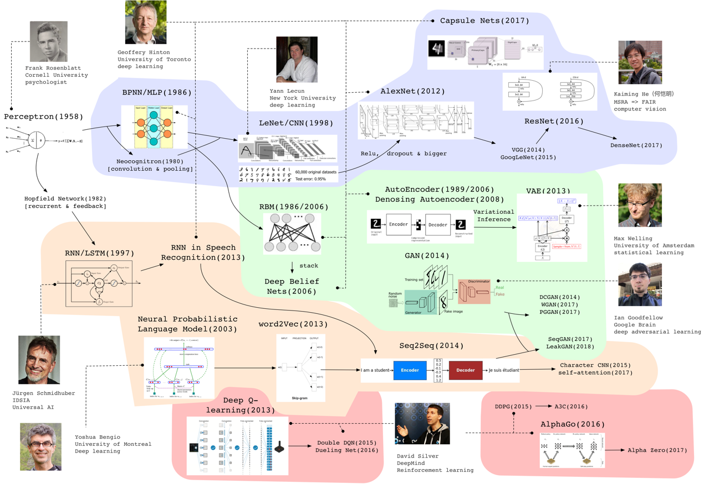
《2020 中国人工智能白皮书》
Computer Vision and CNN
1979, Neocognitron by Fukushima
1986, Backpropogation MLP by Hinton
1998, LeNet-5 by LeCun
2012, AlexNet by Hinton
2016, ResNet by 何恺明
2020, ViT by google
Generative Models
1986-2006, RBM by Hinton
1989/2006, AutoEncoder by Hinton
2014, GAN by Goodfellow
2020, Diffusion model by Ho & Abbeel
2024, Sora by openAI
Sequence Models
1982, Hopfield Network by Hopfield
1997, LSTM by Schmidhuber
2013, RNN by Hinton
2017, transformer by google
2022, chatGPT by openAI
Reinforcement Learning
2013, Deep Q-learning by Silver
2016, AlphaGo by deepmind
2020, AlphaFold by deepmind
Notes:
MLP，多参线性规划
RBM，受限玻尔兹曼机

Slide 19
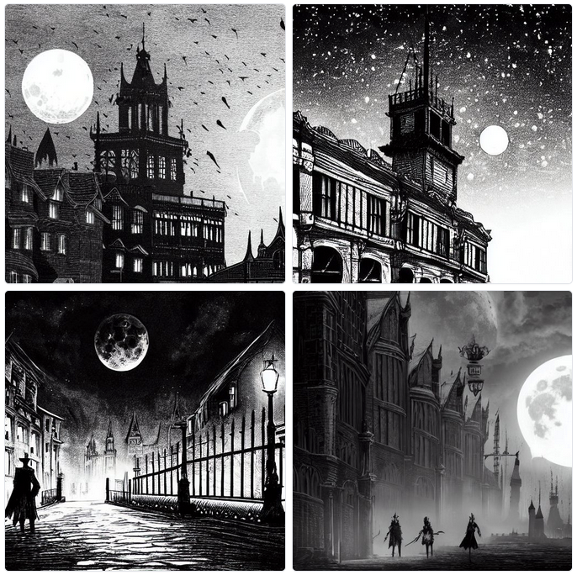
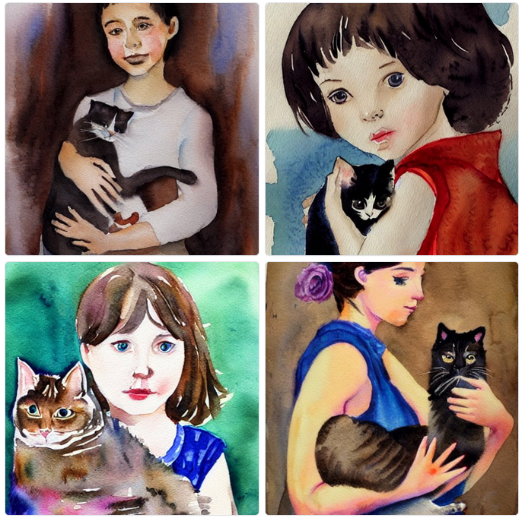
Data Generation: Stable Diffusion for image generation
https://stablediffusionweb.com/#demo
black and white illustration of bloodborne, close-up street view of a Victorian town at night, horrible, moon rising, super detailed, minimalist composition
fine watercolor painting portrait of a girl holding a lazy cat, neat, elegant

Slide 20
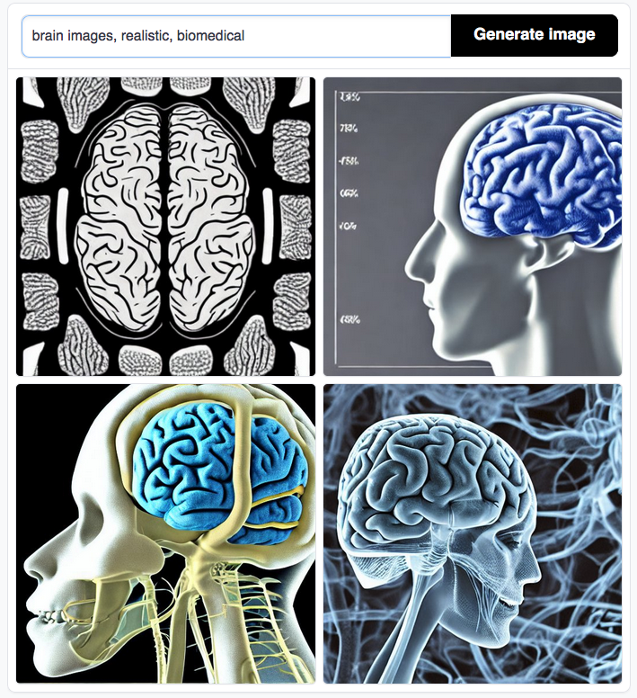
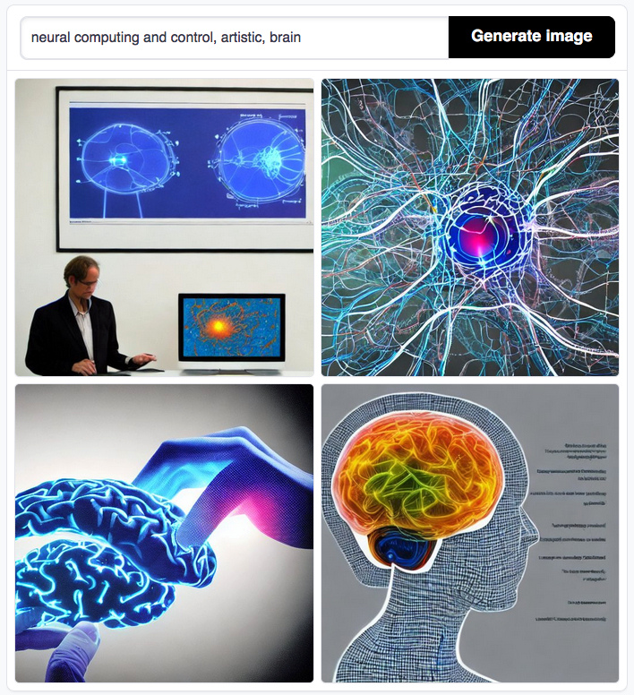
Data Generation: Stable Diffusion for image generation
https://stablediffusionweb.com/#demo

Slide 21
6 steps to be a medical AI expert
Be an AI expert
Understand data: bioelectrical signals, biomedical images
Understand diseases
Know how to talk with medical doctors
Know how to talk with engineers
Define THE problem and solve it with AI
1
2
3
4
5
6

Slide 22
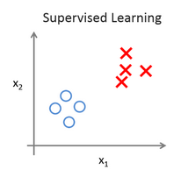
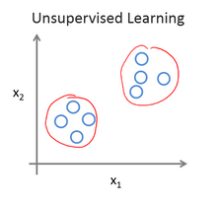
Categories of Machine Learning
Supervised Learning
Unsupervised Learning
Semi-supervised Learning
Given labels e.g. classification, regression
No labels e.g. clustering, data reconstruction
Some labeled data, and some unlabeled data Transductive learning: unlabeled data is the testing data
Inductive learning: unlabeled data is not the testing data
Reinforcement learning: labels are the reward/punishment

Slide 23
3 Key Components of Machine Learning
Data
Model
Optimization algorithm
Without labels: a data point (x), a dataset (X)
With labels: a pair of data (x, y), a dataset (X, Y)
Model: the high-level concept, a function (input, output)
Loss function (objective function) : the goal of machine learning
Parameters: the variables to be learned/estimated
The algorithm to minimize the loss function (or maximize the objective function)

Slide 24
Examples (regression)
Linear regression
Linear regression with L1 regularization (LASSO regression)
Linear regression with L2 regularization (ridge regression)

Slide 25
Examples (classification)
Logistic regression
Logistic regression with L1 regularization
The usefulness of L1 is that it can push feature coefficients to 0, creating a method for feature selection.

Slide 26
Machine learning is everywhere.
After the ML course, you will still do NOT know how to do these.
Please do not be frustrated.
You are a big step towards them.
(You just need learn more courses, and do research projects.)
AlphaGo
da Vinci Surgical System
Autonomous Vehicles
Image processing
ChatGPT

Slide 27

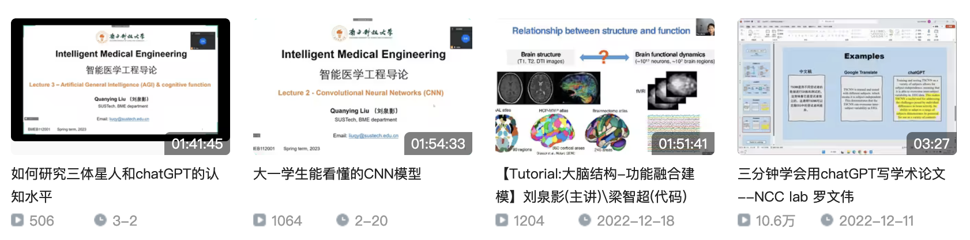
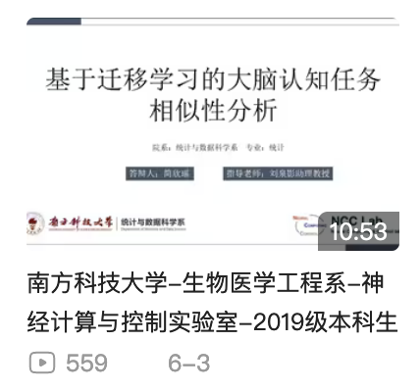
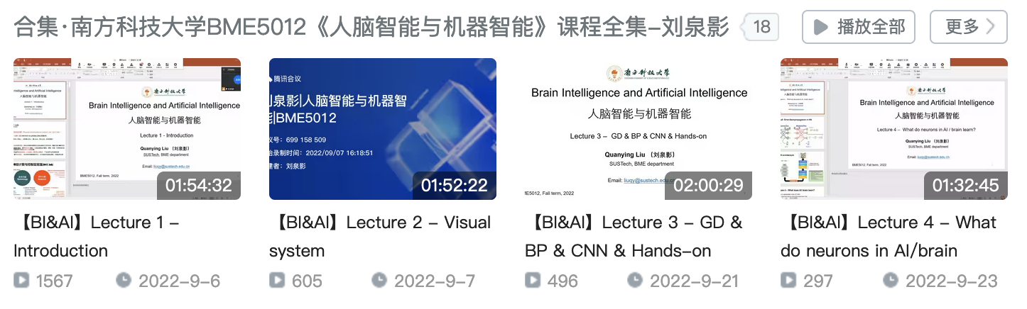
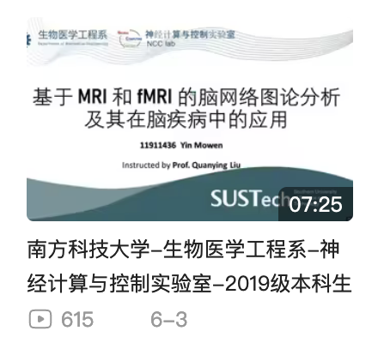
业余时间，做点科普
B站账号：NCC_lab
本科生毕业答辩系列
技
术
干
货
BI
&
AI
课
程

Slide 28
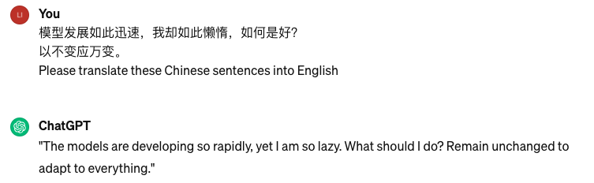
One more thing...

Slide 29
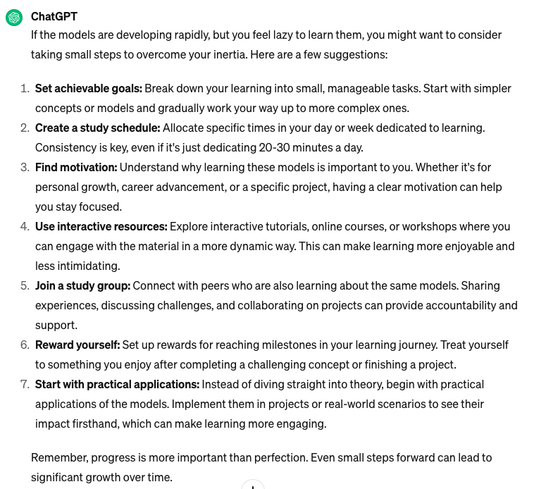
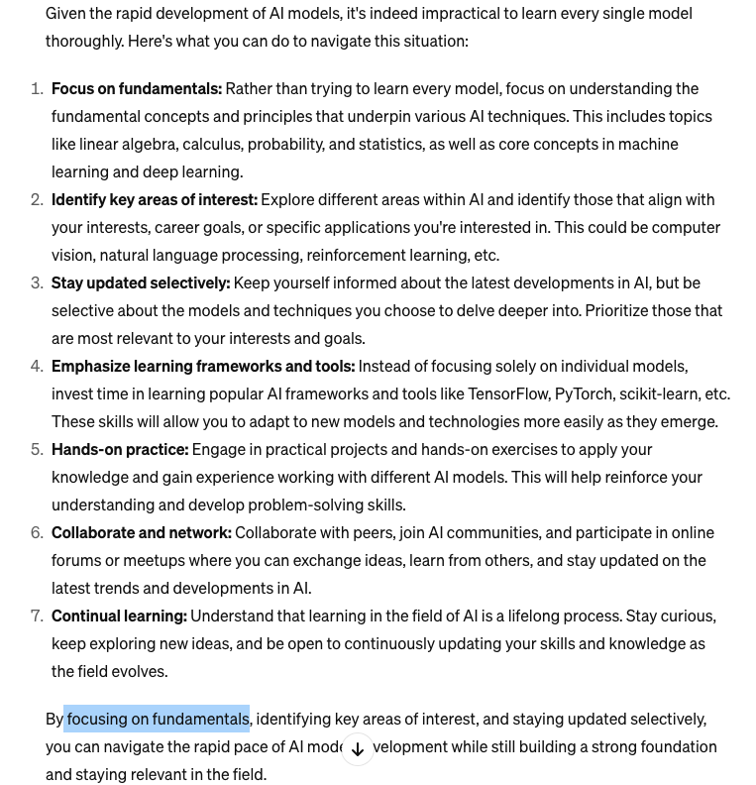
One more thing...
The models are developing so rapidly, yet I am so lazy to learn these models. What should I do?
AI models are developing so fast that it is basically impossible to learn all models. what should I do?

Slide 30
《庄子·内篇·养生主第三》
吾生也有涯，而知也无涯。
以有涯随无涯，殆已！已而为知者，殆而已矣！
为善无近名，为恶无近刑，缘督以为经，可以保身，可以全生，可以养亲，可以尽年。
Notes:
我的生命是有限的，而知识是无限的。
用有限的生命去追求无限的知识，真是累人啊！已经追逐知识的人，可真是疲倦呀。
做了世人所谓的善事却不去贪图名声，做了世人所谓的恶事却不至于面对刑戮的屈辱，沿着名誉与刑罚的缝隙间形成的道路走，遵循了这条人生的正道，那就可以保养身体，可以保全天性，可以修炼精神，可以享尽天年。

Slide 31
大脑智能与人工智能的融合
https://www.bilibili.com/video/BV1qL4y1s7V7

